Slide 1
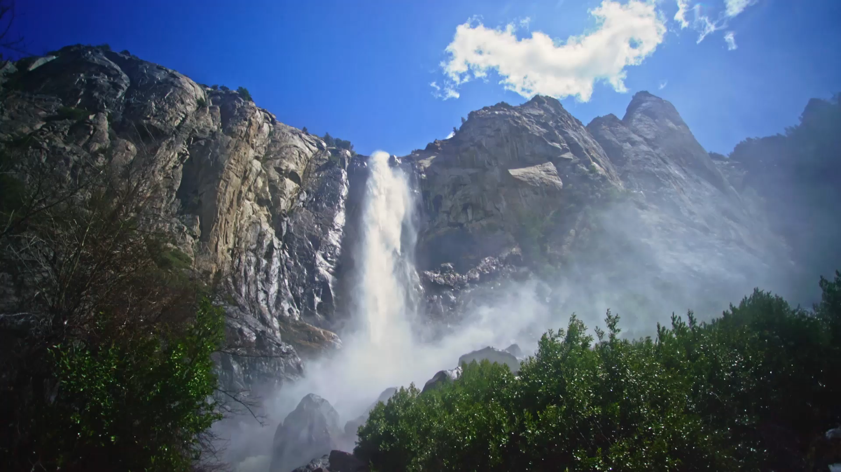
Gradient, Divergence and curl

Slide 2
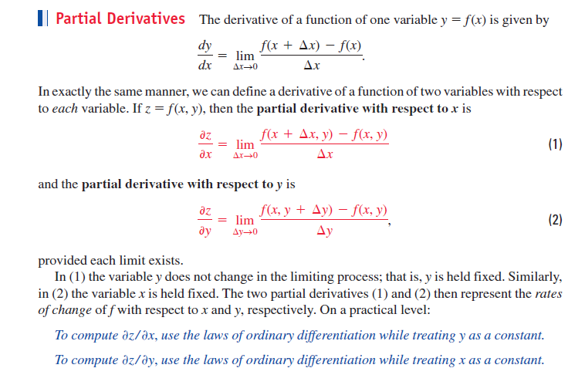

Slide 3
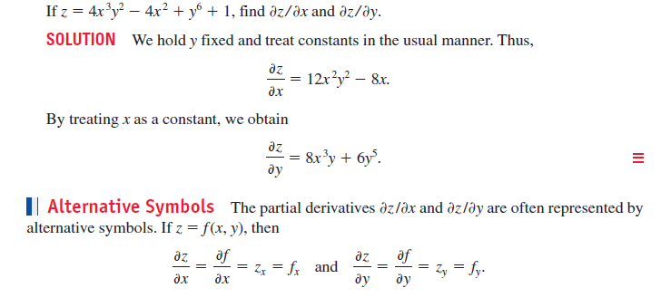

Slide 4
Gradient: Gradient is a vector describing magnitude and direction of the maximum rate of change of a scalar field.
Physical Interpretation of Gradient:
Gradient tells you how much something changes as you move from one point to another

Slide 5
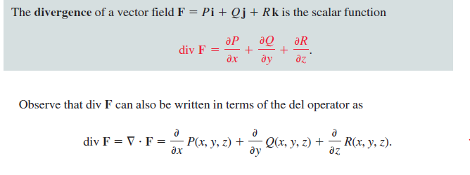
Divergence

Slide 6
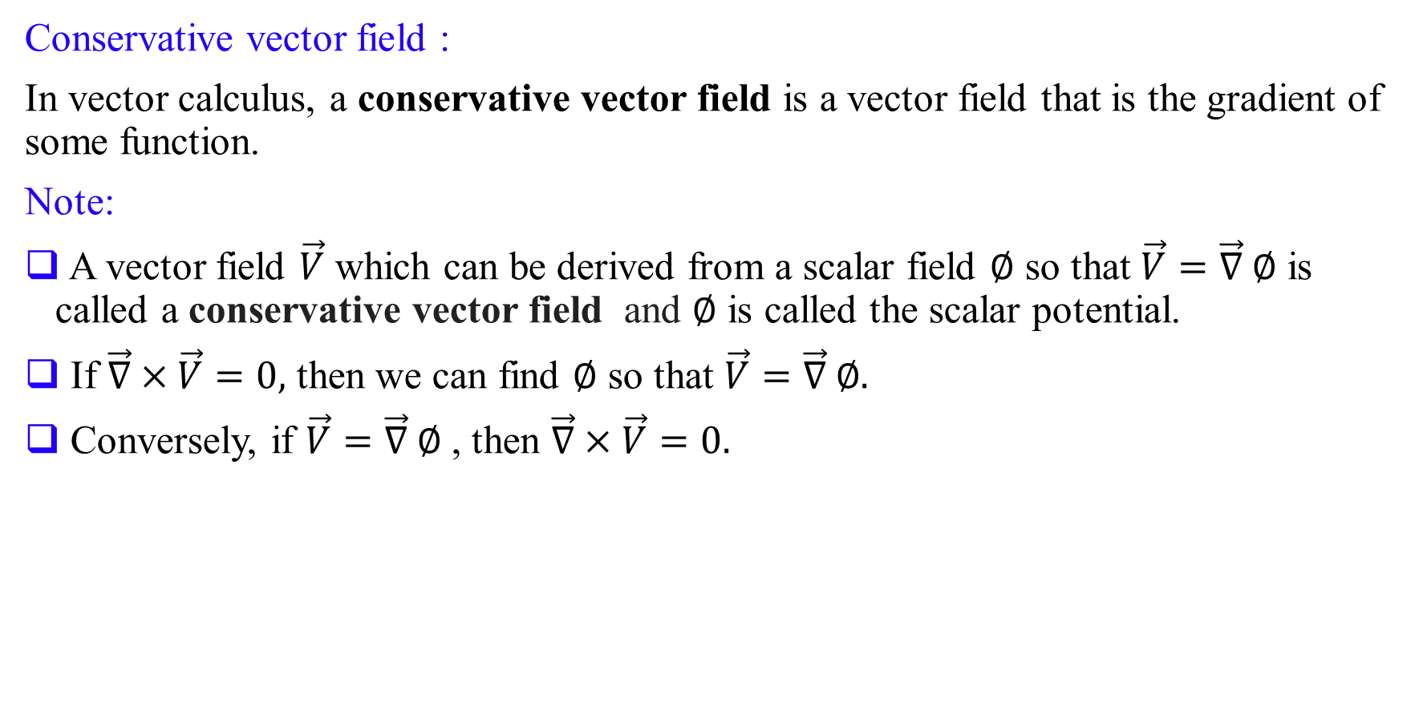
Conservative vector field :
In vector calculus, a conservative vector field is a vector field that is the gradient of some function.
Note:
A vector field $\vec{V}$ which can be derived from a scalar field $∅$ so that $\vec{V}=\vec{∇} ∅$ is called a conservative vector field and $∅$ is called the scalar potential.
If $\vec{∇}×\vec{V}=0,$ then we can find $∅$ so that $\vec{V}=\vec{∇} ∅.$
Conversely, if $\vec{V}=\vec{∇} ∅$ , then $\vec{∇}×\vec{V}=0.$

Slide 7
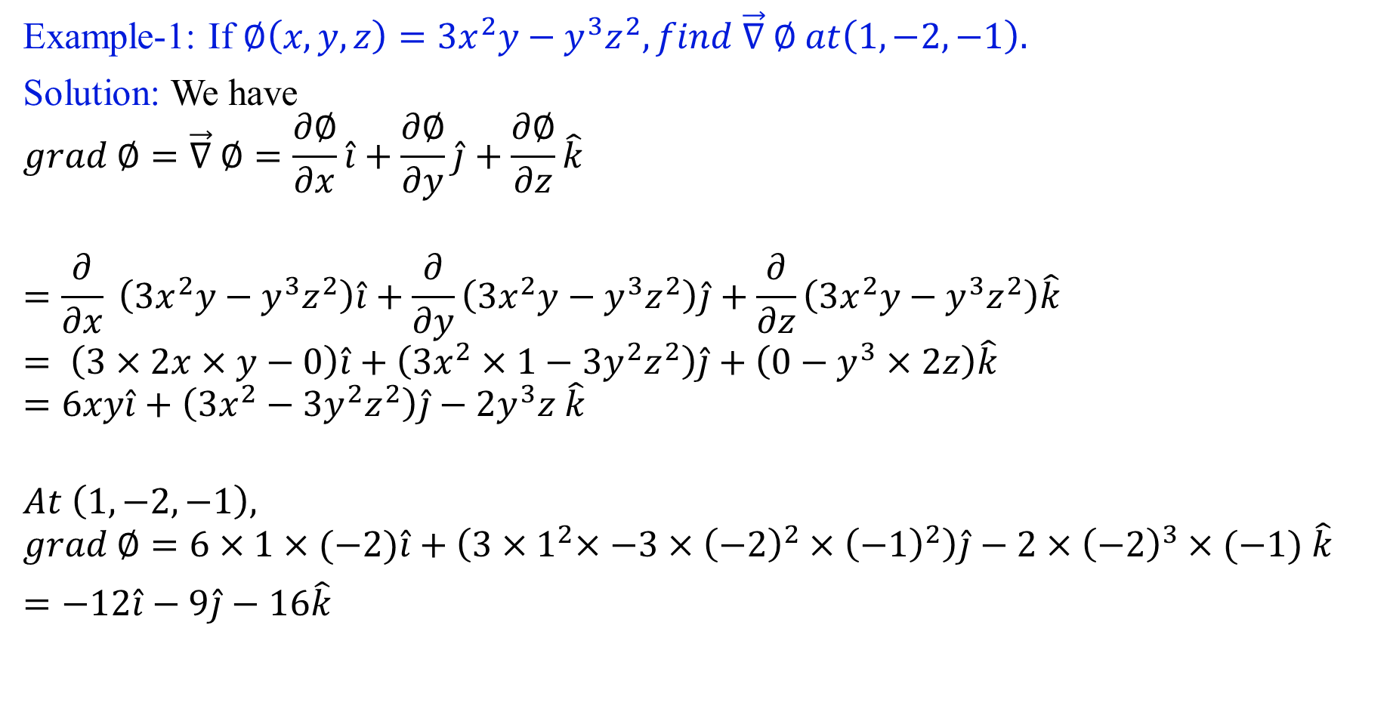
Example-1: If $∅\left(x,y,z\right)=3x^{2}y−y^{3}z^{2}, find \vec{∇} ∅ at\left(1,−2,−1\right).$
Solution: We have
$$grad ∅=\vec{∇} ∅=\frac{∂∅}{∂x}\hat{i}+\frac{∂∅}{∂y}\hat{j}+\frac{∂∅}{∂z}\hat{k}$$
$$=\frac{∂}{∂x} \left(3x^{2}y−y^{3}z^{2}\right)\hat{i}+\frac{∂}{∂y}\left(3x^{2}y−y^{3}z^{2}\right)\hat{j}+\frac{∂}{∂z}\left(3x^{2}y−y^{3}z^{2}\right)\hat{k}$$
$$= \left(3×2x×y−0\right)\hat{i}+\left(3x^{2}×1−{3y}^{2}z^{2}\right)\hat{j}+\left(0−y^{3}×2z\right)\hat{k}$$
$$=6xy\hat{i}+\left(3x^{2}−{3y}^{2}z^{2}\right)\hat{j}−2y^{3}z \hat{k}$$
$$At \left(1,−2,−1\right),$$
$$grad ∅=6×1×(−2)\hat{i}+\left(3{×1}^{2}×−{3×\left(−2\right)}^{2}×{\left(−1\right)}^{2}\right)\hat{j}−2×{\left(−2\right)}^{3}×(−1) \hat{k}$$
$=−12\hat{i}−9\hat{j}−16\hat{k}$

Slide 8
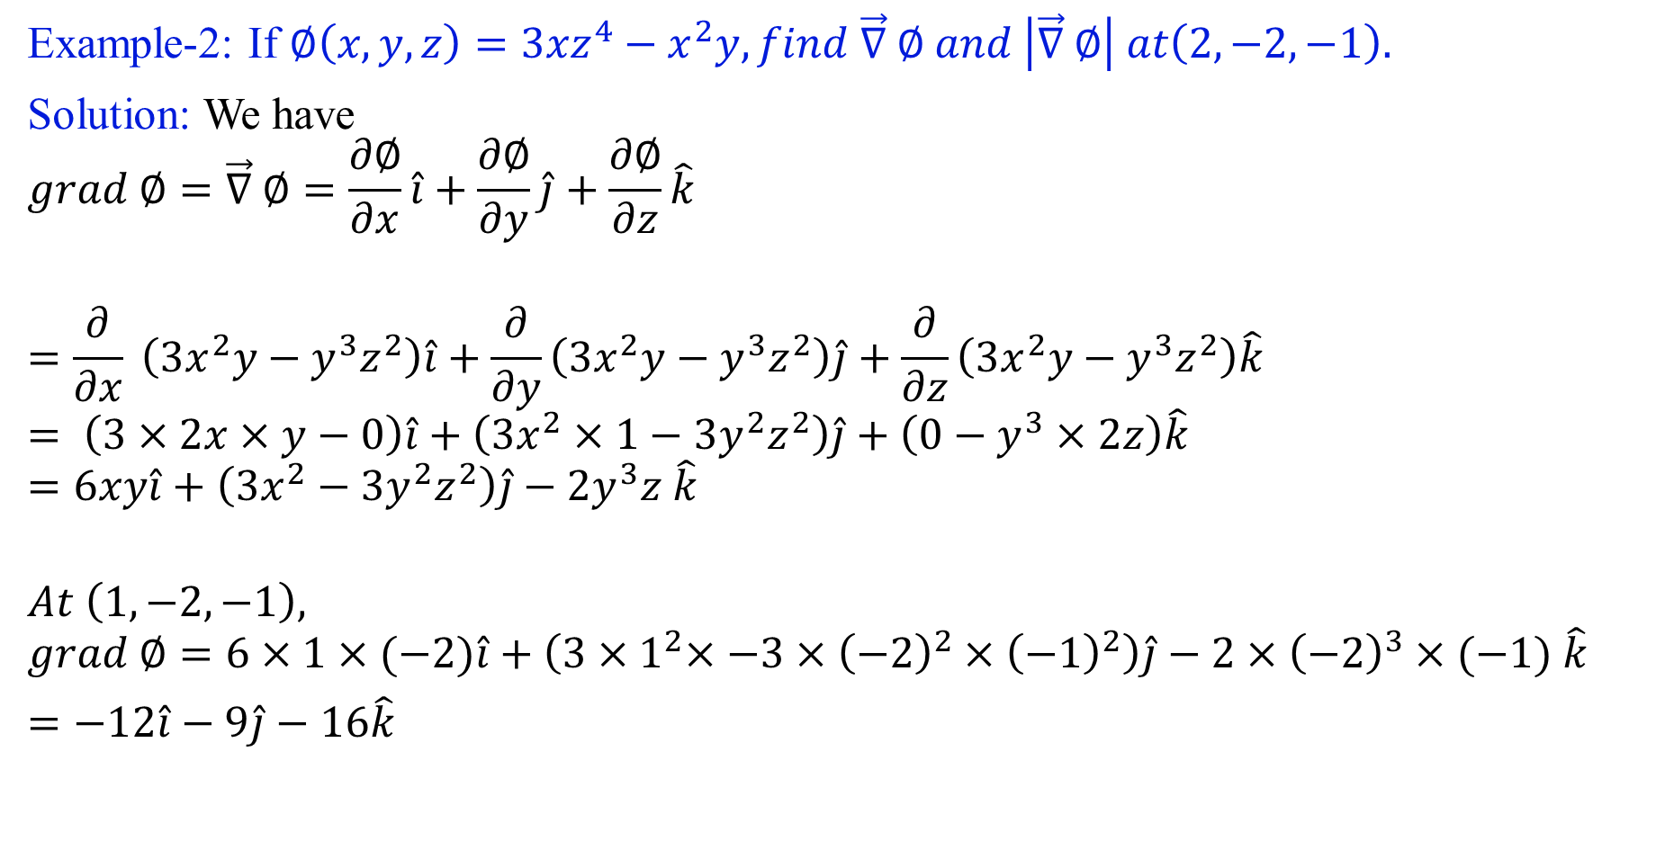
Example-2: If $∅\left(x,y,z\right)=3{xz}^{4}−x^{2}y, find \vec{∇} ∅ and \left|\vec{∇} ∅\right| at\left(2,−2,−1\right).$
Solution: We have
$$grad ∅=\vec{∇} ∅=\frac{∂∅}{∂x}\hat{i}+\frac{∂∅}{∂y}\hat{j}+\frac{∂∅}{∂z}\hat{k}$$
$$=\frac{∂}{∂x} \left(3x^{2}y−y^{3}z^{2}\right)\hat{i}+\frac{∂}{∂y}\left(3x^{2}y−y^{3}z^{2}\right)\hat{j}+\frac{∂}{∂z}\left(3x^{2}y−y^{3}z^{2}\right)\hat{k}$$
$$= \left(3×2x×y−0\right)\hat{i}+\left(3x^{2}×1−{3y}^{2}z^{2}\right)\hat{j}+\left(0−y^{3}×2z\right)\hat{k}$$
$$=6xy\hat{i}+\left(3x^{2}−{3y}^{2}z^{2}\right)\hat{j}−2y^{3}z \hat{k}$$
$$At \left(1,−2,−1\right),$$
$$grad ∅=6×1×(−2)\hat{i}+\left(3{×1}^{2}×−{3×\left(−2\right)}^{2}×{\left(−1\right)}^{2}\right)\hat{j}−2×{\left(−2\right)}^{3}×(−1) \hat{k}$$
$=−12\hat{i}−9\hat{j}−16\hat{k}$

Slide 9
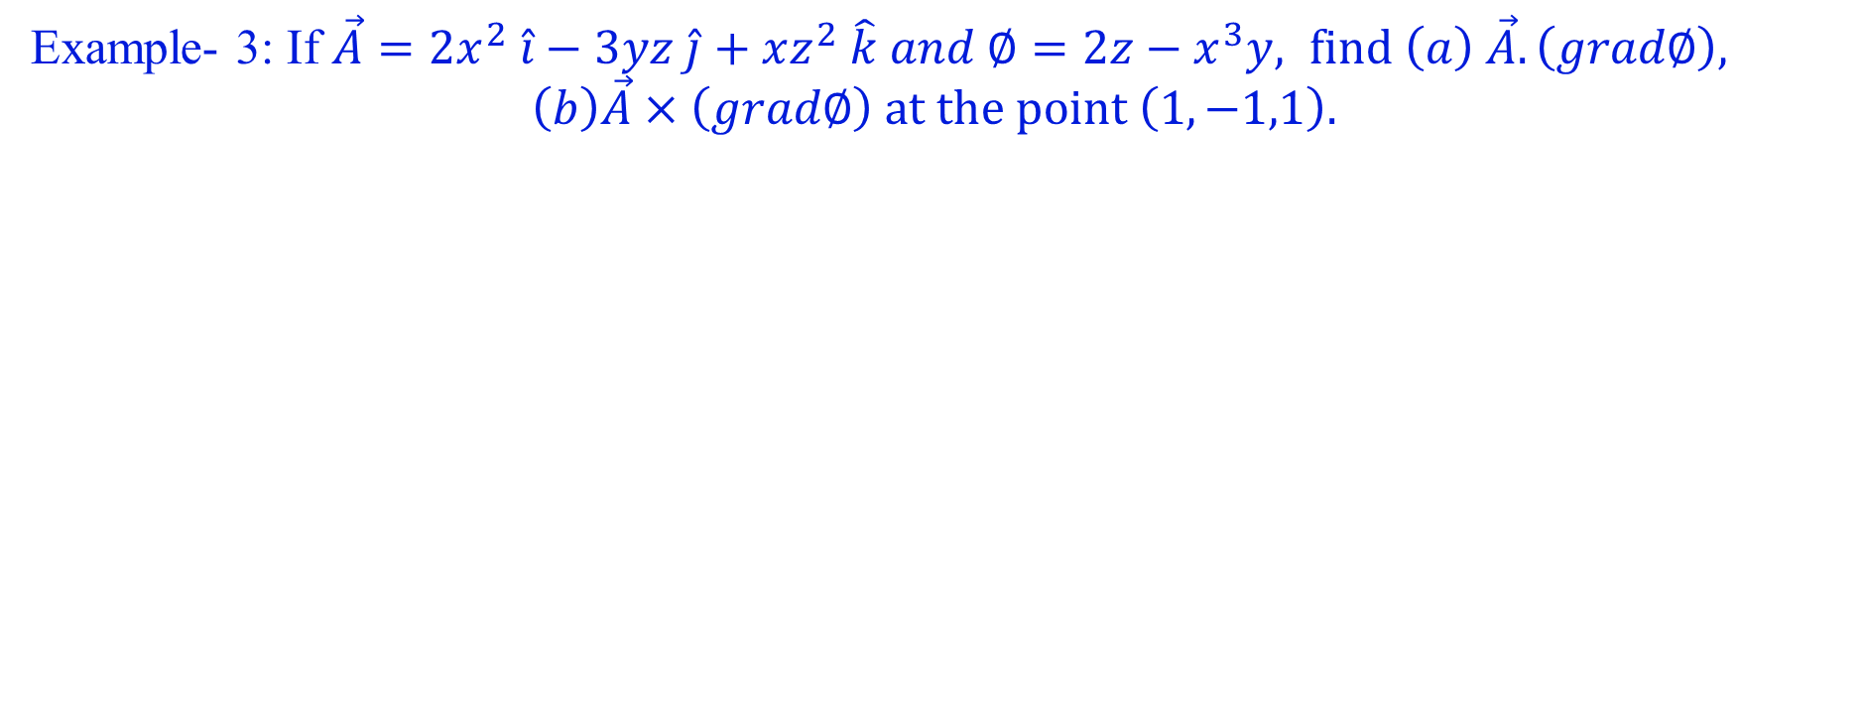
Example- 3: If $\vec{A}=2x^{2} \hat{i}−3yz \hat{j}+xz^{2} \hat{k} and ∅=2z−x^{3}y, find \left(a\right) \vec{A}. \left(grad∅\right),$
$$\left(b\right)\vec{A}×\left(grad∅\right) at the point \left(1,−1,1\right).$$

Slide 10
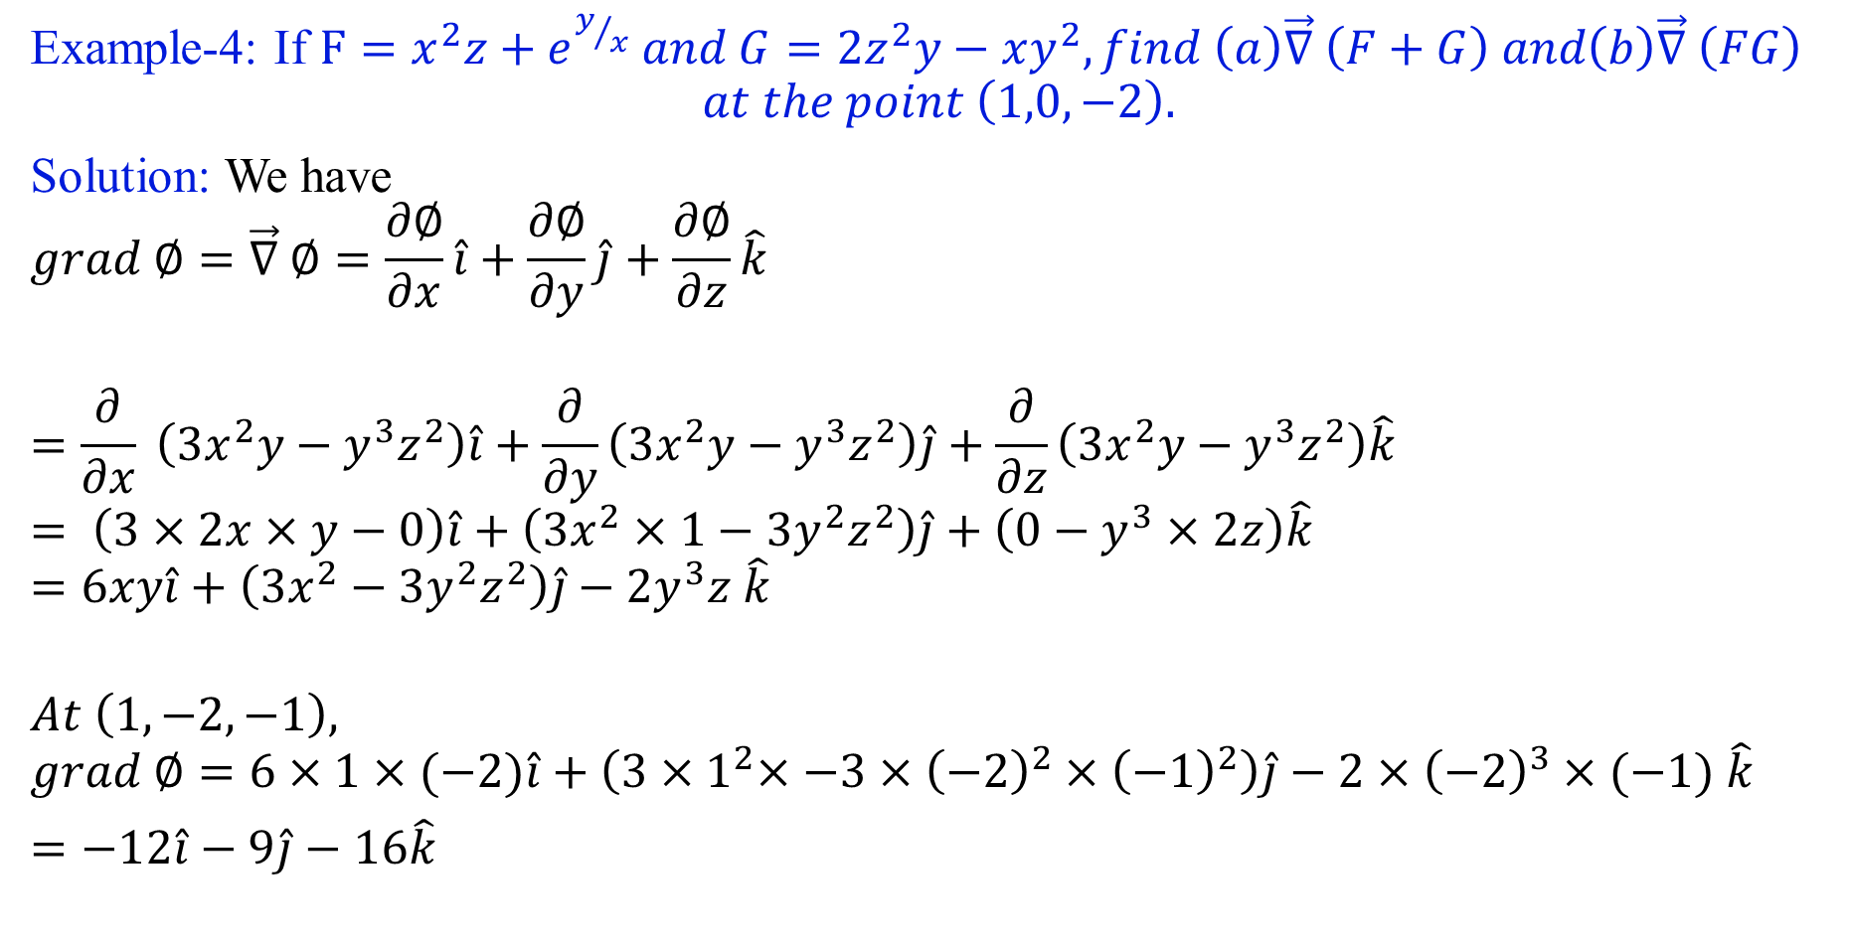
Example-4: If $F=x^{2}z+e^{y/x} and G=2z^{2}y−xy^{2}, find \left(a\right)\vec{∇} \left(F+G\right) and\left(b\right)\vec{∇} \left(FG\right)$
$$at the point \left(1,0,−2\right).$$
Solution: We have
$$grad ∅=\vec{∇} ∅=\frac{∂∅}{∂x}\hat{i}+\frac{∂∅}{∂y}\hat{j}+\frac{∂∅}{∂z}\hat{k}$$
$$=\frac{∂}{∂x} \left(3x^{2}y−y^{3}z^{2}\right)\hat{i}+\frac{∂}{∂y}\left(3x^{2}y−y^{3}z^{2}\right)\hat{j}+\frac{∂}{∂z}\left(3x^{2}y−y^{3}z^{2}\right)\hat{k}$$
$$= \left(3×2x×y−0\right)\hat{i}+\left(3x^{2}×1−{3y}^{2}z^{2}\right)\hat{j}+\left(0−y^{3}×2z\right)\hat{k}$$
$$=6xy\hat{i}+\left(3x^{2}−{3y}^{2}z^{2}\right)\hat{j}−2y^{3}z \hat{k}$$
$$At \left(1,−2,−1\right),$$
$$grad ∅=6×1×(−2)\hat{i}+\left(3{×1}^{2}×−{3×\left(−2\right)}^{2}×{\left(−1\right)}^{2}\right)\hat{j}−2×{\left(−2\right)}^{3}×(−1) \hat{k}$$
$=−12\hat{i}−9\hat{j}−16\hat{k}$

Slide 11
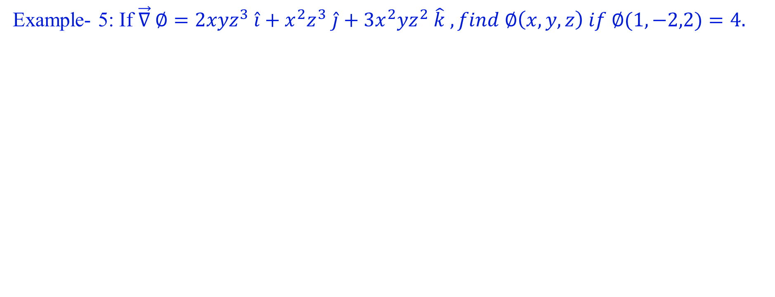
Example- 5: If $\vec{∇} ∅=2{xyz}^{3} \hat{i}+x^{2}z^{3} \hat{j}+3x^{2}yz^{2} \hat{k} , find ∅\left(x,y,z\right) if ∅(1,−2,2)=4.$

Slide 12
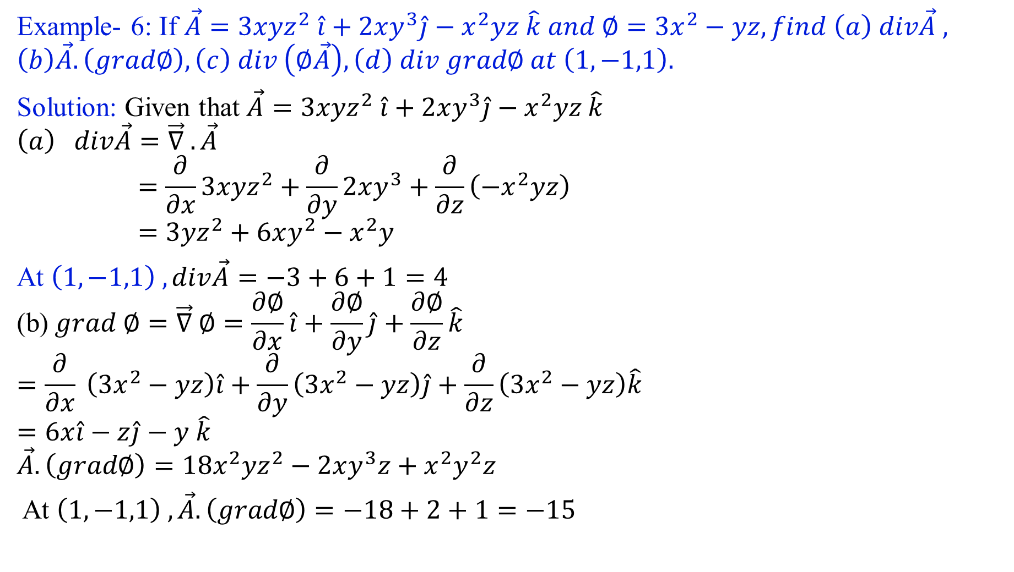
Example- 6: If $\vec{A}=3xyz^{2} \hat{i}+2xy^{3}\hat{j}−x^{2}yz \hat{k} and ∅=3x^{2}−yz, find \left(a\right) div\vec{A} ,$
$$\left(b\right)\vec{A}. \left(grad∅\right), \left(c\right) div \left(∅\vec{A}\right), \left(d\right) div grad∅ at \left(1,−1,1\right).$$
Solution: Given that $\vec{A}=3xyz^{2} \hat{i}+2xy^{3}\hat{j}−x^{2}yz \hat{k}$
$$\left(a\right) div\vec{A}=\vec{∇} .\vec{A}$$
$$=\frac{∂}{∂x}3xyz^{2}+\frac{∂}{∂y}2xy^{3}+\frac{∂}{∂z}\left(−x^{2}yz\right)$$
$$=3yz^{2}+6xy^{2}−x^{2}y$$
At $\left(1,−1,1\right) ,div\vec{A}=−3+6+1=4$
$$\text{(}\text{b}\text{)} grad ∅=\vec{∇} ∅=\frac{∂∅}{∂x}\hat{i}+\frac{∂∅}{∂y}\hat{j}+\frac{∂∅}{∂z}\hat{k}$$
$$=\frac{∂}{∂x} \left(3x^{2}−yz\right)\hat{i}+\frac{∂}{∂y}\left(3x^{2}−yz\right)\hat{j}+\frac{∂}{∂z}\left(3x^{2}−yz\right)\hat{k}$$
$$=6x\hat{i}−z\hat{j}−y \hat{k}$$
$$\vec{A}. \left(grad∅\right)=18x^{2}yz^{2}−2xy^{3}z+x^{2}y^{2}z$$
At $\left(1,−1,1\right) ,\vec{A}. \left(grad∅\right)=−18+2+1=−15$

Slide 13
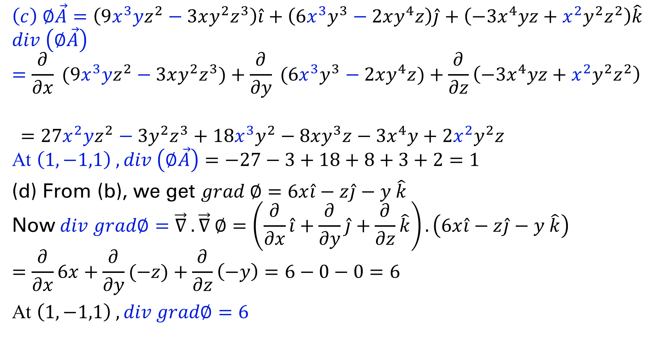
$$\left(c\right) ∅\vec{A}=\left(9x^{3}yz^{2}−3xy^{2}z^{3}\right)\hat{i}+\left(6x^{3}y^{3}−2xy^{4}z\right)\hat{j}+\left(−3x^{4}yz+x^{2}y^{2}z^{2}\right)\hat{k}$$
$$div \left(∅\vec{A}\right)=\frac{∂}{∂x} (9x^{3}yz^{2}−3xy^{2}z^{3})+\frac{∂}{∂y} (6x^{3}y^{3}−2xy^{4}z)+\frac{∂}{∂z}\left(−3x^{4}yz+x^{2}y^{2}z^{2}\right)$$
$$=27x^{2}yz^{2}−3y^{2}z^{3}+18x^{3}y^{2}−8xy^{3}z−3x^{4}y+2x^{2}y^{2}z$$
$$\text{At} \left(1,−1,1\right) ,div \left(∅\vec{A}\right)=−27−3+18+8+3+2=1$$
(d) From (b), we get $grad ∅=6x\hat{i}−z\hat{j}−y \hat{k}$
$$\text{Now} div grad∅=\vec{∇} .\vec{∇} ∅=\left(\frac{∂}{∂x}\hat{i}+\frac{∂}{∂y}\hat{j}+\frac{∂}{∂z}\hat{k}\right).\left(6x\hat{i}−z\hat{j}−y \hat{k}\right)$$
$$=\frac{∂}{∂x}6x+\frac{∂}{∂y}(−z)+\frac{∂}{∂z}\left(−y\right)=6−0−0=6$$
At $\left(1,−1,1\right) ,div grad∅=6$

Slide 14
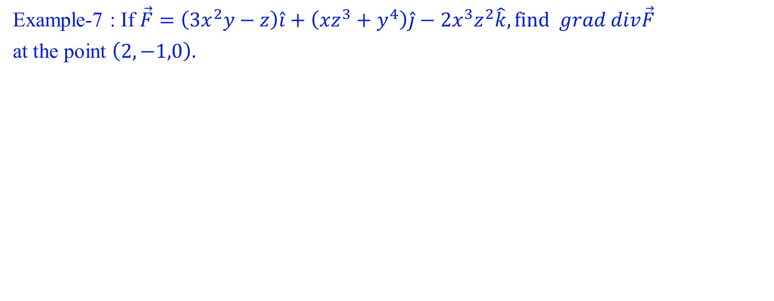
Example-7 : If $\vec{F}=\left(3x^{2}y−z\right)\hat{i}+\left(x{z^{3}+y}^{4}\right)\hat{j}−2x^{3}z^{2}\hat{k}, find grad div\vec{F}$
at the point $\left(2,−1,0\right).$

Slide 15
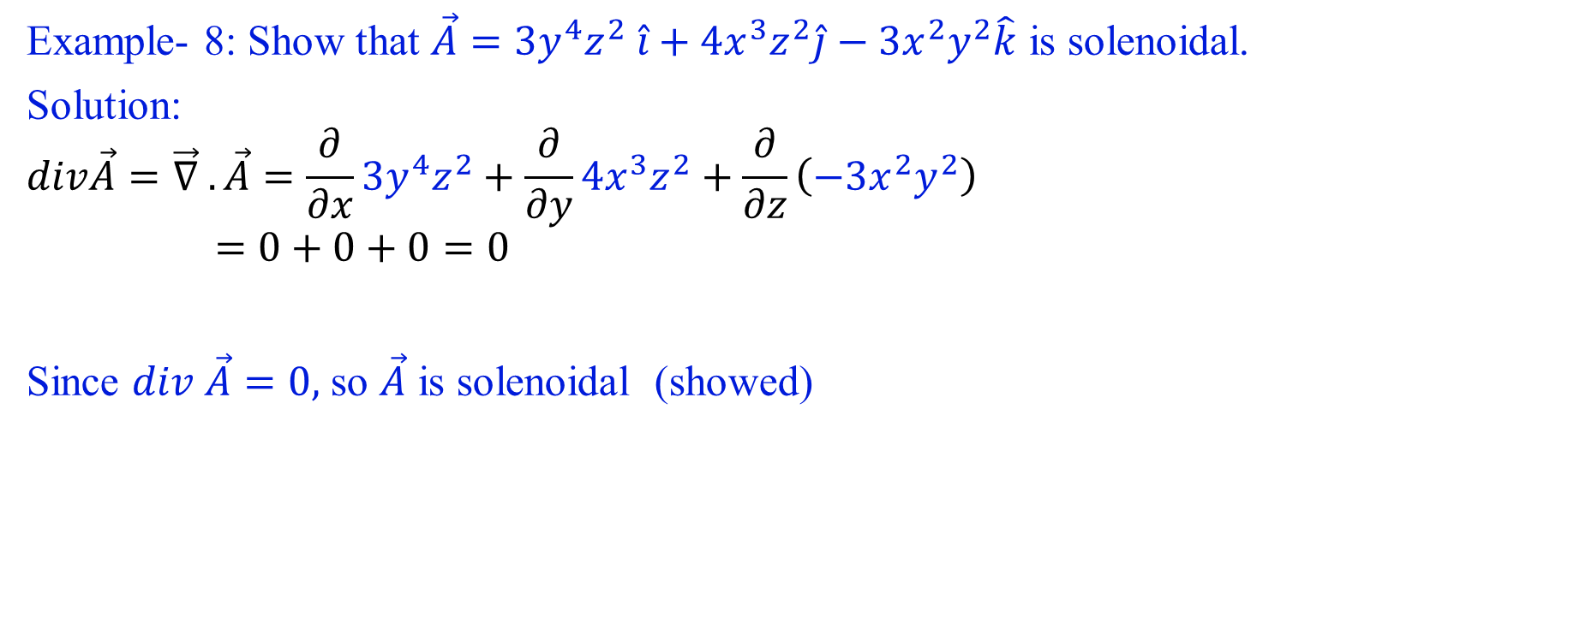
Example- 8: Show that $\vec{A}=3y^{4}z^{2} \hat{i}+4x^{3}z^{2}\hat{j}−3x^{2}y^{2}\hat{k}$ is solenoidal.
Solution:
$$div\vec{A}=\vec{∇} .\vec{A}=\frac{∂}{∂x}3y^{4}z^{2}+\frac{∂}{∂y}4x^{3}z^{2}+\frac{∂}{∂z}\left(−3x^{2}y^{2}\right)$$
$$=0+0+0=0$$
Since $div \vec{A}=0,$ so $\vec{A}$ is solenoidal (showed)

Slide 16
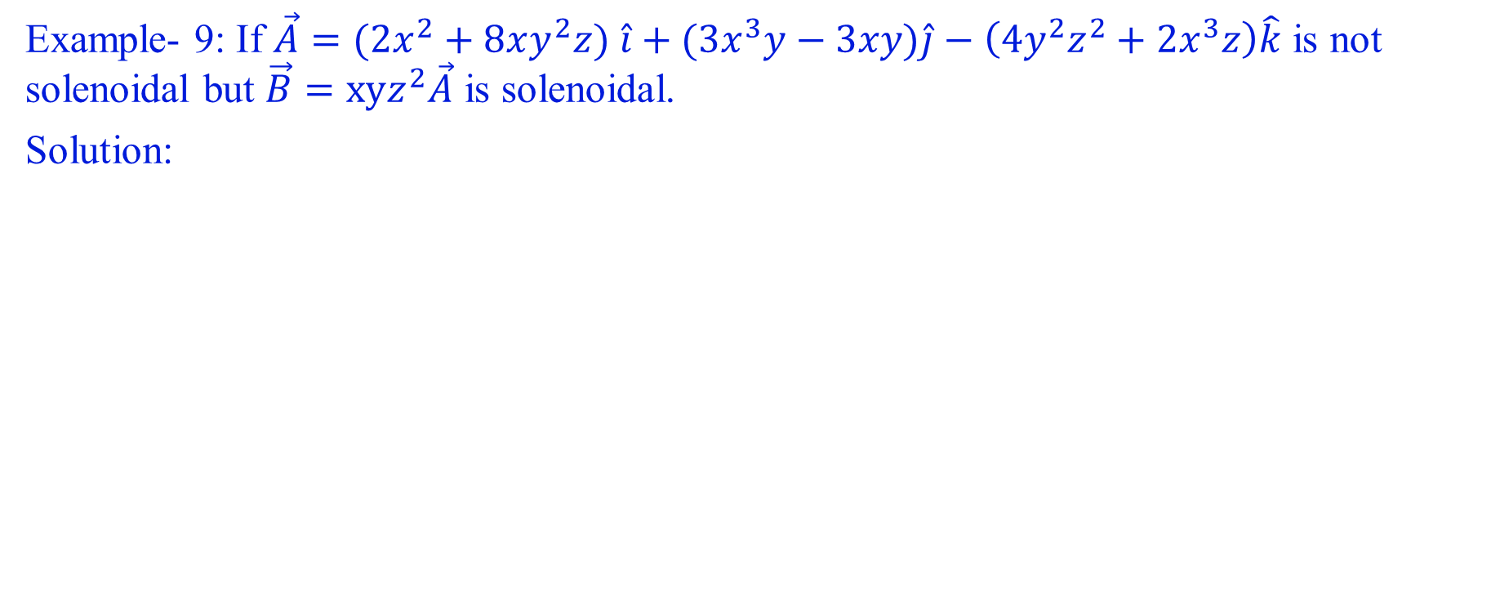
Example- 9: If $\vec{A}=(2x^{2}+8xy^{2}z) \hat{i}+(3x^{3}y−3xy)\hat{j}−\left(4y^{2}z^{2}+2x^{3}z\right)\hat{k}$ is not solenoidal but $\vec{B}=xyz^{2}\vec{A}$ is solenoidal.
Solution:

Slide 17
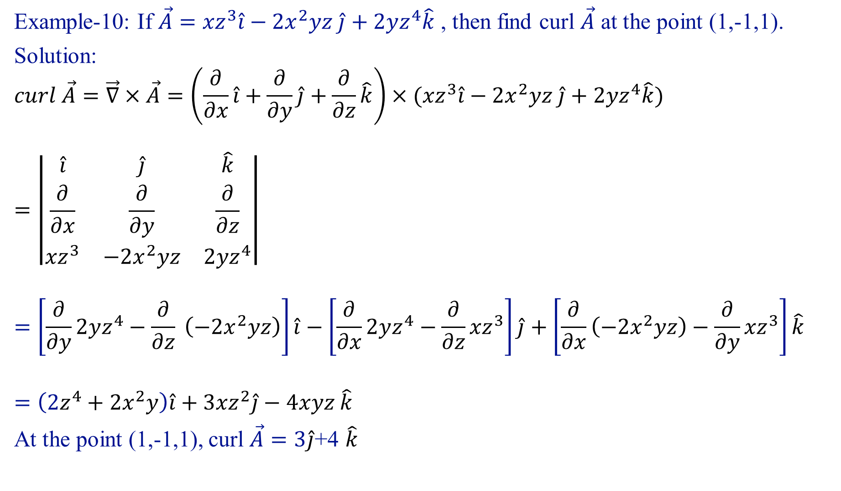
Example-10: If $\vec{A}={xz}^{3}\hat{i}−2x^{2}yz \hat{j}+2yz^{4}\hat{k}$ , then find curl $\vec{A}$ at the point (1,-1,1).
Solution:
$$curl \vec{A}=\vec{∇}×\vec{A}=\left(\frac{∂}{∂x}\hat{i}+\frac{∂}{∂y}\hat{j}+\frac{∂}{∂z}\hat{k}\right)×({xz}^{3}\hat{i}−2x^{2}yz \hat{j}+2yz^{4}\hat{k})$$
$$=\left|\begin{matrix}\hat{i} & \hat{j} & \hat{k} \\ \frac{∂}{∂x} & \frac{∂}{∂y} & \frac{∂}{∂z} \\ {xz}^{3} & −2x^{2}yz & 2yz^{4}\end{matrix}\right|$$
$$=\left[\frac{∂}{∂y}2yz^{4}−\frac{∂}{∂z} \left(−2x^{2}yz\right)\right]\hat{i}−\left[\frac{∂}{∂x}2yz^{4}−\frac{∂}{∂z}{xz}^{3}\right]\hat{j}+\left[\frac{∂}{∂x}\left(−2x^{2}yz\right)−\frac{∂}{∂y}{xz}^{3}\right]\hat{k}$$
$$=\left(2z^{4}+2x^{2}y\right)\hat{i}+3{xz}^{2}\hat{j}−4xyz \hat{k}$$
At the point (1,-1,1), curl $\vec{A}=3\hat{j}$+4 $\hat{k}$

Slide 18
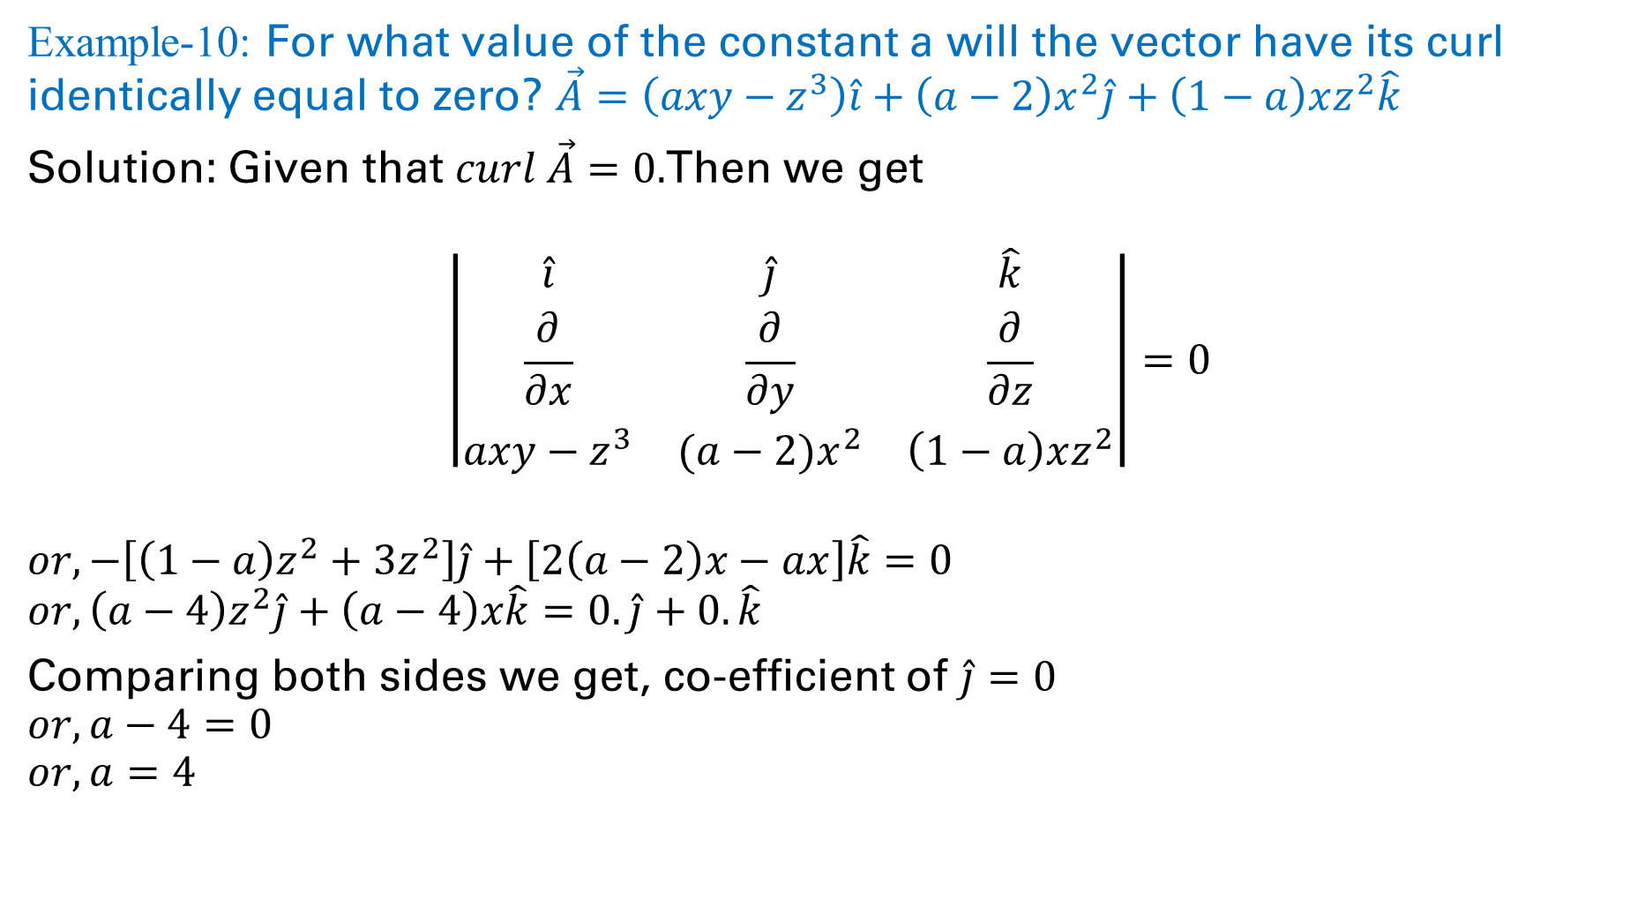
Example-10: For what value of the constant a will the vector have its curl identically equal to zero? $\vec{A}=\left({axy−z}^{3}\right)\hat{i}+\left(a−2\right)x^{2}\hat{j}+\left(1−a\right)xz^{2}\hat{k}$
Solution: Given that $curl \vec{A}=0.$Then we get
$$\left|\begin{matrix}\hat{i} & \hat{j} & \hat{k} \\ \frac{∂}{∂x} & \frac{∂}{∂y} & \frac{∂}{∂z} \\ {axy−z}^{3} & (a−2)x^{2} & \left(1−a\right)xz^{2}\end{matrix}\right|=0$$
$$or, −\left[\left(1−a\right)z^{2}+3z^{2}\right]\hat{j}+\left[2\left(a−2\right)x−ax\right]\hat{k}=0$$
$$or,\left(a−4\right)z^{2}\hat{j}+\left(a−4\right)x\hat{k}=0.\hat{j}+0.\hat{k}$$
Comparing both sides we get, co-efficient of $\hat{j}=0$
$$or, a−4=0$$
$$or, a=4$$

Slide 19
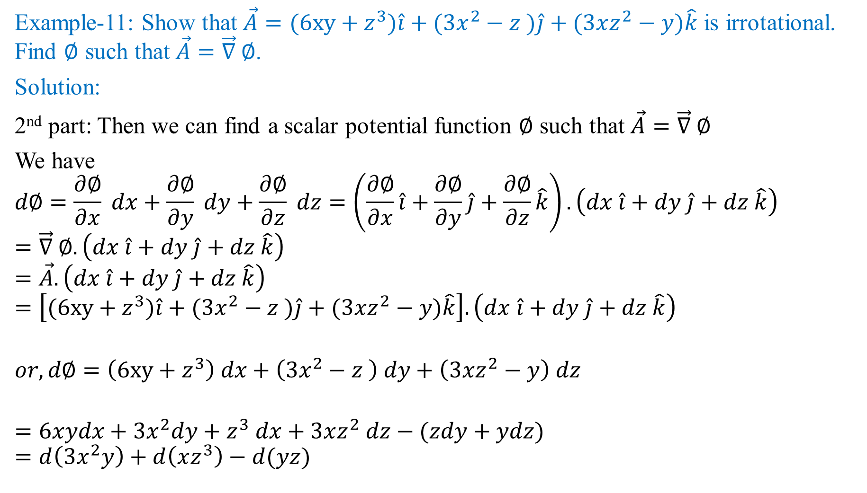
Example-11: Show that $\vec{A}=(6xy+z^{3})\hat{i}+(3x^{2}−z )\hat{j}+(3xz^{2}−y)\hat{k}$ is irrotational. Find $∅$ such that $\vec{A}=\vec{∇} ∅$.
Solution:
2nd part: Then we can find a scalar potential function $∅$ such that $\vec{A}=\vec{∇} ∅$
We have
$$d∅=\frac{∂∅}{∂x} dx+\frac{∂∅}{∂y} dy+\frac{∂∅}{∂z} dz=\left(\frac{∂∅}{∂x}\hat{i}+\frac{∂∅}{∂y}\hat{j}+\frac{∂∅}{∂z}\hat{k}\right).\left(dx \hat{i}+dy \hat{j}+dz \hat{k}\right)$$
$$=\vec{∇} ∅.\left(dx \hat{i}+dy \hat{j}+dz \hat{k}\right)$$
$$=\vec{A}.\left(dx \hat{i}+dy \hat{j}+dz \hat{k}\right)$$
$$=\left[(6xy+z^{3})\hat{i}+(3x^{2}−z )\hat{j}+(3xz^{2}−y)\hat{k}\right].\left(dx \hat{i}+dy \hat{j}+dz \hat{k}\right)$$
$$or,d∅=\left(6xy+z^{3}\right) dx+\left(3x^{2}−z \right) dy+\left(3xz^{2}−y\right) dz$$
$$=6xydx+3x^{2}dy+z^{3} dx+3xz^{2} dz−(zdy+ydz)$$
$$=d\left(3x^{2}y\right)+d\left(xz^{3}\right)−d(yz)$$

Slide 20
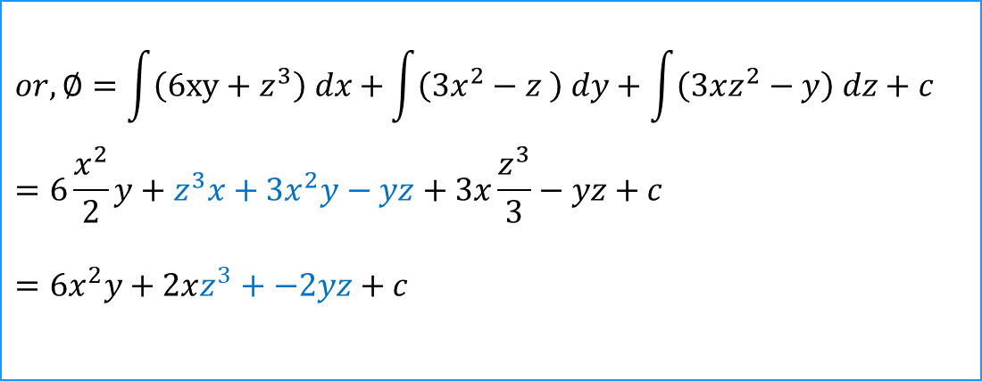
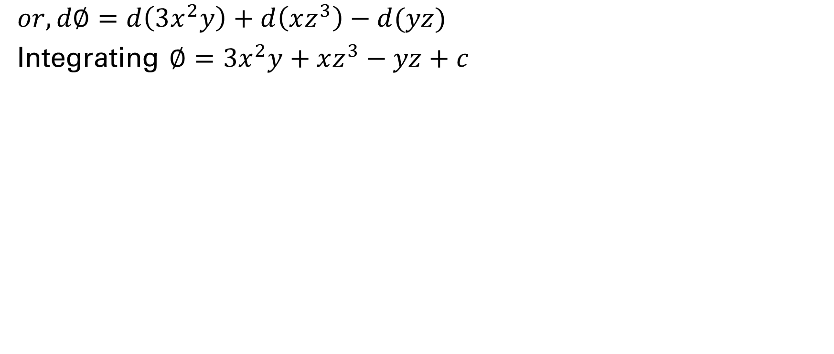
$$or,d∅=d\left(3x^{2}y\right)+d\left(xz^{3}\right)−d(yz)$$
Integrating $∅=3x^{2}y+xz^{3}−yz+c$
$$or, ∅=\int{\left(6xy+z^{3}\right) dx+}\int{\left(3x^{2}−z \right) dy+\int{\left(3xz^{2}−y\right) dz+c}}$$
$$=6\frac{x^{2}}{2}y+z^{3}x+3x^{2}y−yz+3x\frac{z^{3}}{3}−yz+c$$
$$={6x}^{2}y+2xz^{3}+−2yz+c$$

Slide 22
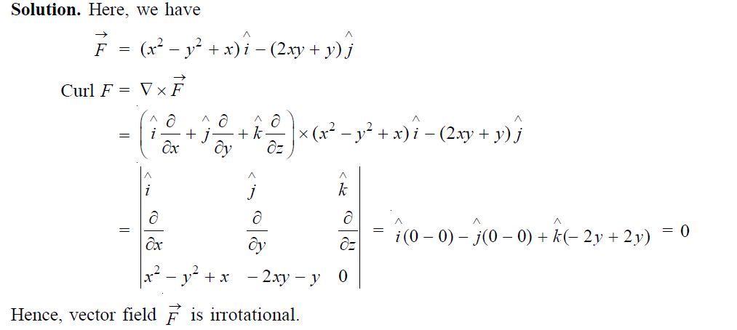
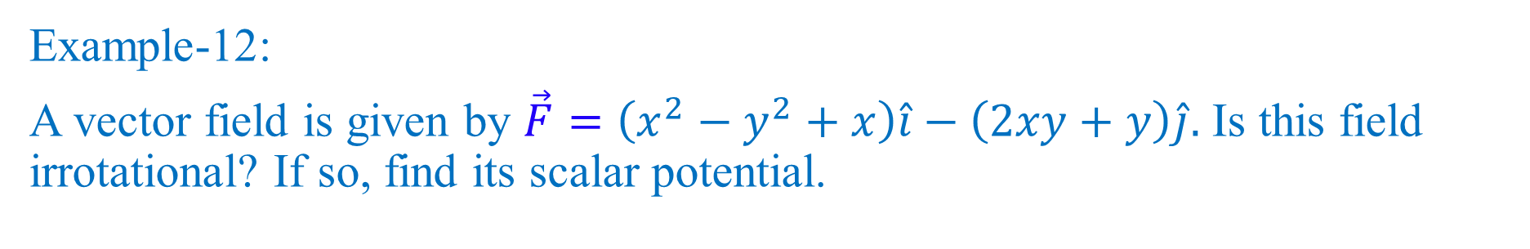
Example-12:
A vector field is given by $\vec{F}=\left(x^{2}−y^{2}+x\right)\hat{i}−\left(2xy+y\right)\hat{j}.$ Is this field irrotational? If so, find its scalar potential.

Slide 23
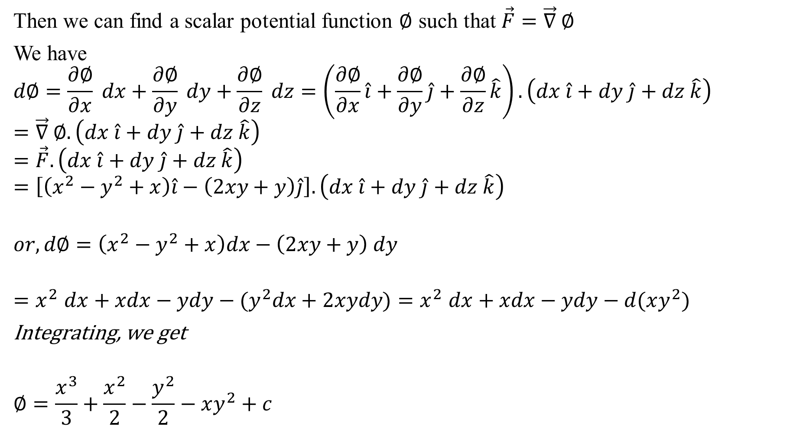
Then we can find a scalar potential function $∅$ such that $\vec{F}=\vec{∇} ∅$
We have
$$d∅=\frac{∂∅}{∂x} dx+\frac{∂∅}{∂y} dy+\frac{∂∅}{∂z} dz=\left(\frac{∂∅}{∂x}\hat{i}+\frac{∂∅}{∂y}\hat{j}+\frac{∂∅}{∂z}\hat{k}\right).\left(dx \hat{i}+dy \hat{j}+dz \hat{k}\right)$$
$$=\vec{∇} ∅.\left(dx \hat{i}+dy \hat{j}+dz \hat{k}\right)$$
$$=\vec{F}.\left(dx \hat{i}+dy \hat{j}+dz \hat{k}\right)$$
$$=\left[\left(x^{2}−y^{2}+x\right)\hat{i}−\left(2xy+y\right)\hat{j}\right].\left(dx \hat{i}+dy \hat{j}+dz \hat{k}\right)$$
$$or,d∅=\left(x^{2}−y^{2}+x\right)dx−\left(2xy+y\right) dy$$
$${=x}^{2}dx+xdx−ydy−{(y}^{2}dx+2xydy){=x}^{2}dx+xdx−ydy−d(xy^{2})$$
Integrating, we get
$$∅=\frac{x^{3}}{3}+\frac{x^{2}}{2}−\frac{y^{2}}{2}−xy^{2}+c$$

Slide 25
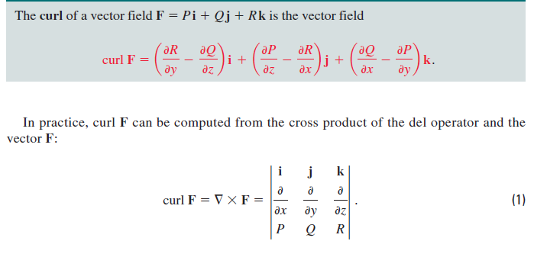
CURL

